Slide 1
Getting Started with Office 365 Authentication and Authorization

Slide 2
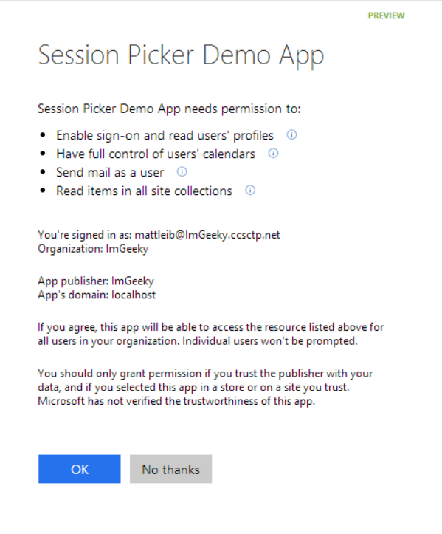
Azure AD OAuth in Office 365
Single auth flow for Office 365
Azure AD Graph, Exchange, SharePoint
Device apps and web sites
Admin and end-user consent
Secure protocol
OAuth 2.0
No capturing user credentials
Fine-grained access scopes
Long-term access through refresh tokens
Notes:
With the Office 365 APIs, which leverage the Azure AD Oauth service, device apps no longer need to store user credentials.
Azure AD has implemented a “Common Consent” dialog, providing a consistent interface for permission grants.
Typically, OAuth is used to access a single resource. Common Consent is unique in that it can provide a token to Exchange Mail/Calendar/Contacts as well as SharePoint lists and files in OneDrive .

Slide 3
OAuth Basics and Authentication Flow

Slide 4
Authentication to Office 365 APIs using Resource Id
Azure AD Authorization
Endpoint
Azure AD Token
Endpoint
Native Application
Office 365 API
Request authorization code
Sign-in via browser pop-up
Return authorization code
Redeem authorization code and acquire access token for Office 365 resource
Return access token and refresh token
Call Office 365 API using the access token
Return Http Response
Notes:
** This slide has animations **
To facilitate the issuance of tokens for multiple resources, a different approach is required.
Instead of requesting an access token from the Authorization Endpoint, an authorization code is requested. The Resource Id for which a token is desired in included in the call to the Authorization Endpoint. The Authorization Endpoint will ensure the user is logged in, and will present the Common Consent dialog that lists the permissions requested by the application.
The authorization code is redeemed at the new Token Endpoint, which returns an access token and a refresh token. The token is issued for the resource identified in the authorization code request.
The access token is used to access the resource. The access token represents the user’s permissions to the resource. The application permission is granted during common consent.

